Slide 1
IBM University Engagement Project Submission
“Exploring the Power of Agentic AI with IBM Granite and LangFlow”

Slide 2

Project Tile – Social Media Agent
Domain of Project – Education
Student Name | Recent Passport Photo | Email ID | Mobile number [WhatsApp]
Hinaxiben Patel |  | hinaxi.patel@bvmengineering.ac.in | 8866338060

Slide 3
Problem Statement No. 10 : Social Media Agent
The Challenge
Brands, influencers, and organizations struggle to keep up with the fast-paced and fragmented world of social media. Content trends evolve hourly, audience sentiment shifts rapidly, and competitor strategies are difficult to track. Managing multiple platforms often leads to scattered insights, missed engagement opportunities, and ineffective campaigns. The challenge is not only to collect social media data but also to analyze, predict, and recommend actions in real time.
The Objective
Build an agentic AI application that acts as an intelligent social media companion. The solution should:
Fuse Multichannel Data :- Collect and synthesize content, comments, hashtags, and competitor posts from platforms like X, LinkedIn, Instagram, and Facebook into unified insights.
Enable Multimodal Interaction :- Accept user inputs (text, images, or voice prompts) and generate creative post drafts, captions, or campaign ideas aligned with brand tone.
Create a Predictive & Agentic Layer :- Forecast trending hashtags, audience sentiment shifts, and competitor engagement patterns while suggesting the best posting schedules.
Visualize Social Media Pulse :- Provide a dashboard with real-time analytics—engagement trends, influencer mapping, sentiment tracking, and campaign performance forecasts.

Slide 4
Proposed Solution -
The proposed solution is a multi-agent “Social Media Agent” built using LangFlow, IBM watsonx.ai, and IBM Granite Models to automate the creation, review, and optimization of high-quality social media content. The system addresses challenges such as time-consuming content creation, inconsistent messaging, and platform-specific content adaptation through an intelligent, modular architecture.
At its core, the solution utilizes LangFlow to orchestrate multiple AI agents while leveraging IBM watsonx.ai to access Granite foundation models for natural language understanding, content generation, and optimization. Users simply provide a topic, target platform, audience, campaign objective, and preferred tone, and the system generates a polished, publication-ready social media post.
The system consists of two key agents:
Content Generation Agent analyzes the user's requirements and creates engaging, platform-specific social media content for platforms such as LinkedIn, Instagram, Facebook, and X (Twitter). It generates compelling captions, relevant hashtags, suitable emojis, and effective call-to-action (CTA) statements while adapting the writing style to the selected platform.
Review & Optimization Agent evaluates the generated content for grammar, readability, clarity, consistency, and platform suitability. It refines sentence structure, removes repetitive content, improves engagement, validates hashtag relevance, and ensures the final post maintains a professional tone without altering factual information or introducing unsupported claims.
The solution provides a simple and interactive interface through LangFlow's chat component, allowing users to generate optimized social media content in real time. The modular architecture enables future enhancements such as multilingual content generation, AI-based image captioning, trend-aware hashtag recommendations, sentiment analysis, post scheduling, and direct integration with social media platforms.
LangFlow orchestrates the workflow between the agents, IBM watsonx.ai provides secure access to enterprise-grade AI services, and Granite Models perform intelligent reasoning, content generation, language refinement, and contextual optimization.
Overall, the proposed solution delivers an end-to-end intelligent social media assistant that helps businesses, marketers, educators, and content creators produce engaging, accurate, and platform-optimized content efficiently while significantly reducing manual effort and improving content quality.

Slide 5
Technology Used
Langflow platform -For designing and orchestrating multi-agent workflows visually
IBM Grainte model (e.g., ibm-granite-3-2-8b-instruct) – Used for natural language understanding, content generation, reasoning, language refinement, and platform-specific content optimization. Granite models generate engaging social media posts and improve their quality based on user requirements.
IBM Cloud – Provides a secure, reliable, and scalable cloud infrastructure for developing, deploying, and managing the Social Media Agent. IBM Cloud ensures high availability, security, and efficient execution of AI-powered workflows.
IBM Watsonx.ai - Provides access to IBM Granite foundation models, enabling model deployment, prompt execution, AI governance, and enterprise-grade generative AI capabilities. It powers the intelligent content generation and optimization process used by the multi-agent system.

Slide 6
Langflow component Used -
Chat Input – Provides the interface where users enter their social media requirements, such as the topic, target platform (LinkedIn, Instagram, Facebook, or X), target audience, campaign objective, tone, and any additional instructions.
IBM watsonx AI Agent - Connects LangFlow with IBM watsonx.ai to access IBM Granite foundation models. It processes user prompts and powers both the Content Generation Agent and the Review & Optimization Agent.
Name of IBM Granite model - Granite-3.2-8B-Instruct (ibm/granite-3-2-8b-instruct) is used for natural language understanding, content generation, reasoning, and platform-specific optimization to produce high-quality social media posts.
AI Agent Components –
Content Generation Agent: Generates engaging, platform-specific social media posts, including captions, hashtags, emojis (when appropriate), and call-to-action (CTA).
Review & Optimization Agent: Reviews and refines the generated content by improving grammar, readability, engagement, consistency, and platform suitability before producing the final output.
Chat output -Displays the final optimized social media post, including the title, platform, caption, hashtags, and CTA, ready for publishing.
Agent Instructions – Stores the system prompts and agent instructions that define the behavior, responsibilities, and output format of each AI agent, ensuring consistent and high-quality responses throughout the workflow.

Slide 7
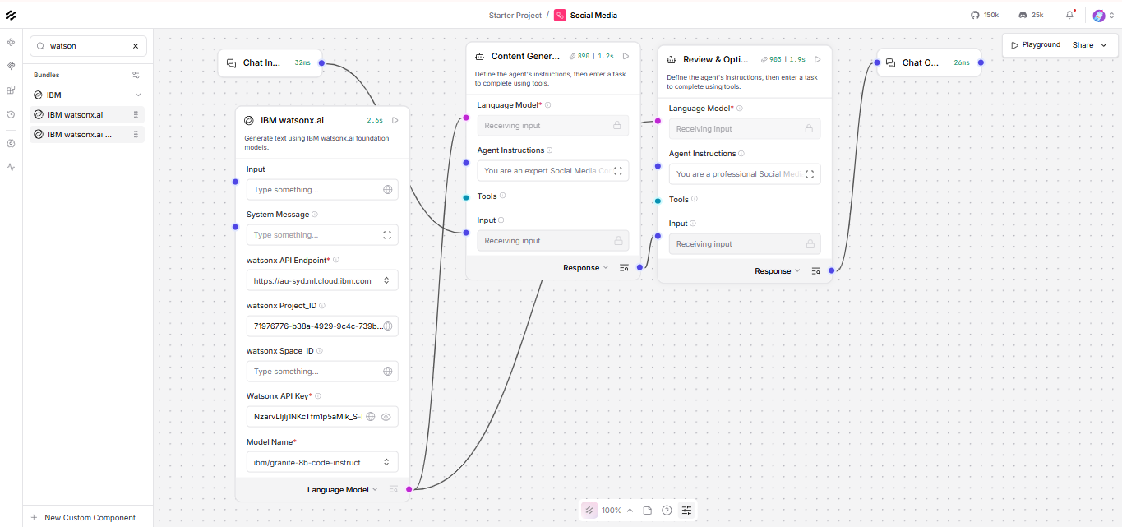
Langflow workflow -

Slide 8
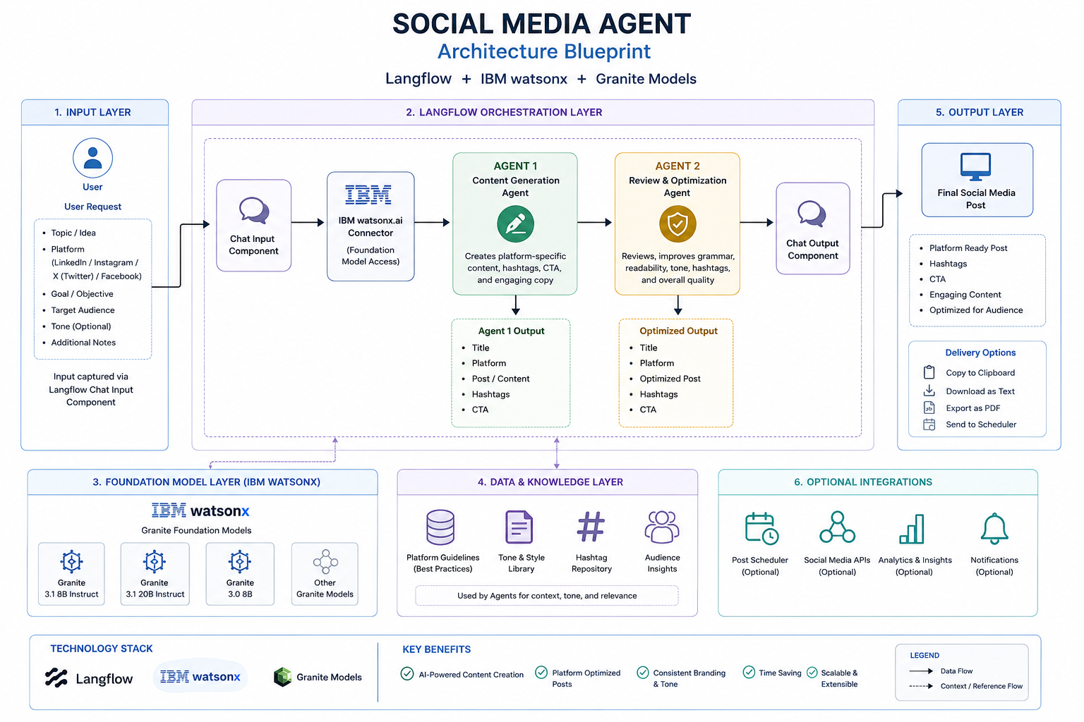
Architecture blueprint

Slide 9

Role of Agentic AI in the solution
Agentic AI serves as the core intelligence of the proposed Social Media Agent by enabling multiple AI agents to collaborate autonomously and perform specialized tasks. Instead of relying on a single AI model, the solution divides the workflow into dedicated agents, resulting in more accurate, engaging, and high-quality social media content.
The Content Generation Agent understands the user's requirements, such as the topic, target platform, audience, objective, and tone, and generates platform-specific social media posts with relevant hashtags, emojis (when appropriate), and an effective call-to-action.
The generated content is then processed by the Review & Optimization Agent, which improves grammar, readability, consistency, and platform-specific tone while ensuring the content is polished, engaging, and ready for publication.
LangFlow orchestrates the interaction between the agents, while IBM watsonx.ai and IBM Granite models provide advanced language understanding, reasoning, and content generation capabilities, enabling an efficient and scalable multi-agent workflow.
By leveraging Agentic AI, the solution delivers:
Autonomous multi-agent collaboration for content creation and review.
High-quality, platform-specific social media posts.
Improved consistency, readability, and engagement.
Reduced manual effort and faster content generation.
A scalable architecture that can be extended with additional agents such as hashtag recommendation, sentiment analysis, multilingual translation, image caption generation, and social media scheduling.

Slide 10
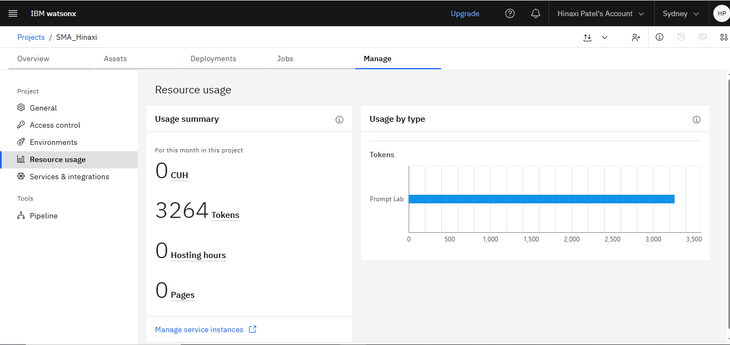
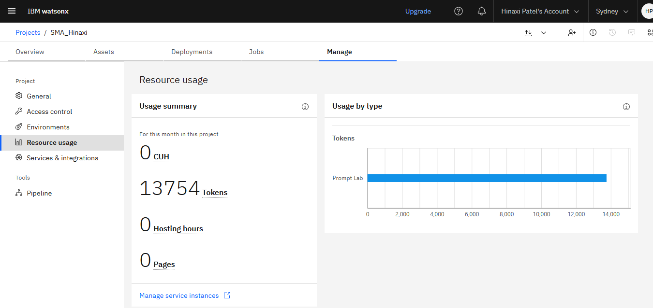
Token Usage
13754 token are used
Before Prompt
After the Prompt
·
·
·

Slide 11
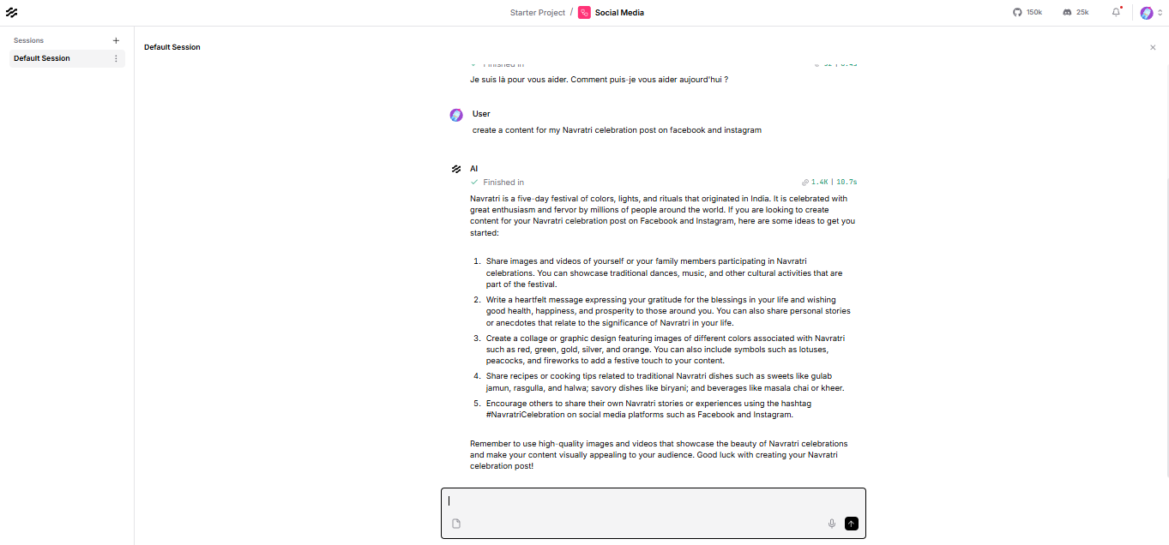
Langflow Output Screenshot
·
·
·

Slide 12
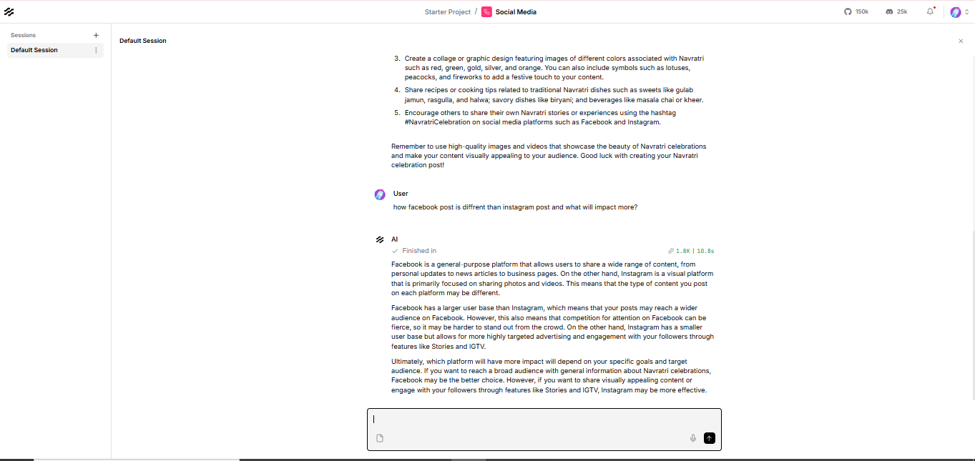
Langflow Output Screenshot
·
·
·

Slide 13
Novelty and Uniqueness
The proposed Social Media Agent combines LangFlow, IBM watsonx.ai, and IBM Granite Models in a multi-agent architecture for intelligent social media content creation. Unlike traditional AI content generators that use a single prompt-response approach, this solution separates content generation and content review into two specialized AI agents. The Content Generation Agent creates engaging, platform-specific posts, while the Review & Optimization Agent refines them for grammar, readability, consistency, engagement, and platform suitability. This collaborative workflow produces high-quality, reliable, and publication-ready social media content.
Key Novel Features
Multi-Agent Architecture: Uses dedicated AI agents for content generation and quality optimization instead of a single AI model.
Platform-Specific Content Creation: Automatically adapts the writing style for LinkedIn, Instagram, Facebook, and X (Twitter).
AI-Based Content Optimization: Enhances grammar, readability,
engagement, hashtag relevance, and call-to-action before publication.
Visual Workflow Orchestration: Uses LangFlow's no-code visual interface to design and manage the complete AI workflow.
Enterprise AI Integration: Leverages IBM watsonx.ai and IBM Granite Models for secure, scalable, and enterprise-grade generative AI.
Scalable Design: The modular architecture allows easy integration of future capabilities such as multilingual content generation, sentiment analysis, trend-aware hashtag recommendations, AI image captioning, and social media scheduling.
It offers an intelligent, scalable, and enterprise-ready approach to social media content creation by combining multi-agent collaboration with IBM's generative AI ecosystem, delivering faster, more engaging, and publication-ready social media content.

Slide 14
Git Hub Link
https://github.com/hinaxipatel/FDP-IBM
·
·
·

Slide 15
Future Scope
Trend Analysis: Integrate real-time social media trend analysis to generate content based on trending topics, hashtags, and current events.
Multilingual Content Generation: Support multiple languages to help businesses and creators reach global audiences.
AI Image Generation: Integrate image generation models to automatically create visually appealing graphics and social media creatives that complement the generated captions.
Social Media Scheduling: Connect with platforms such as LinkedIn, Facebook, Instagram, and X (Twitter) APIs to schedule and publish posts automatically.
Performance Analytics: Analyze post engagement metrics such as likes, comments, shares, impressions, and click-through rates to recommend content improvements.
Sentiment Analysis: Evaluate audience sentiment from comments and reactions to help users understand public perception and improve future content.
Content Calendar Management: Automatically generate weekly or monthly content calendars based on marketing goals and important events.
·
·
·

Slide 16
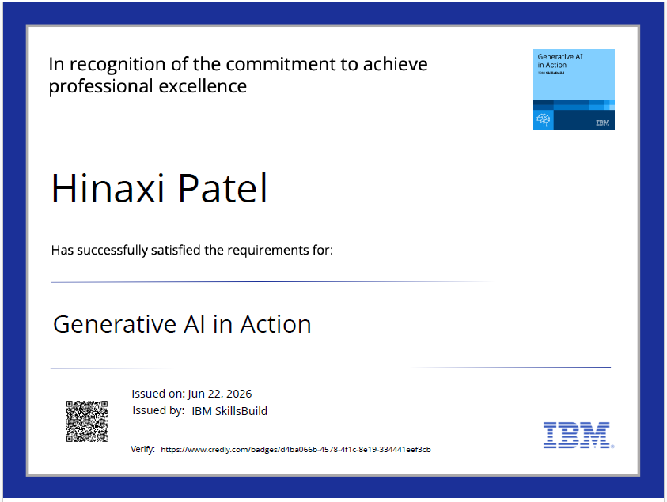

Certificates Earned:

Slide 17
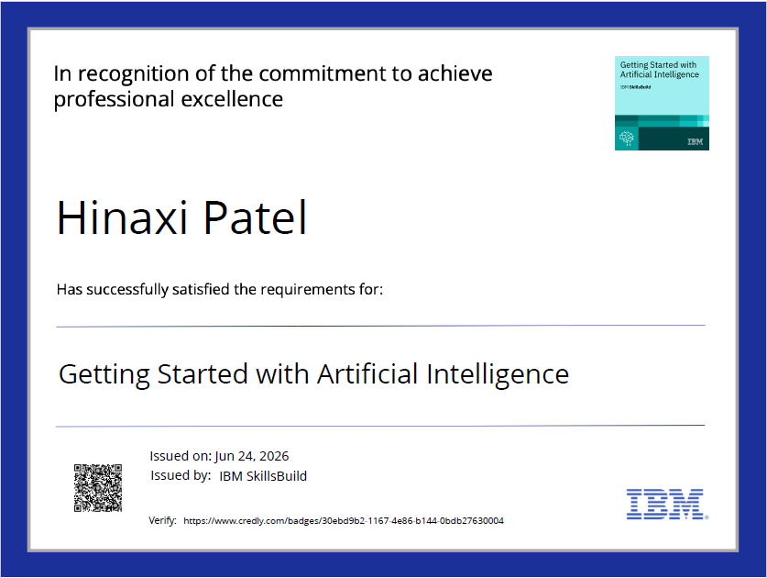
Certificates Earned:

Slide 18

Certificates Earned:

Slide 19

Certificates Earned:​

Slide 20


